Slide 1
Cincyville Tech Circle and Data & Analytics Meetup
Shawn Wallace
October 2022

Slide 2

A word about productizing patterns.
Notes:
Quote

Slide 3
Agility’s Affect on Solutions

Slide 4
Business
Application Development
Analytics

Slide 5
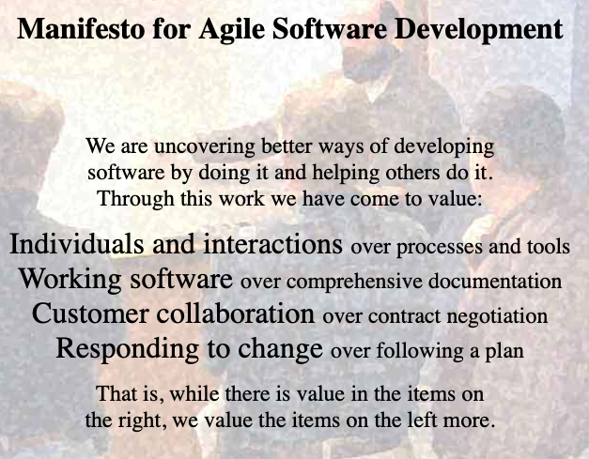
Business
Application Development
Analytics

Slide 6
Business
Application Development
Analytics
Tension
Notes:
???

Slide 7
Conflict led to innovations and capabilities
Notes:
Cloud
Automation
Test Automation
Continuous Integration
Continuous Delivery
Streaming Analytics
Business Agility

Slide 8
Business Consulting Services
MSD
Salesforce
Modern Workplace
Data & Analytics
Notes:
Let’s change to Centric terminlogoy and align to our Service Offerings

Slide 9
MSD
Salesforce
Modern Workplace
Business Consulting Services
Data & Analytics

Slide 10
Before 2020
MSD
Salesforce
Modern Workplace
Business Consulting Services
Data & Analytics

Slide 11
2021
MSD
Salesforce
Modern Workplace
Business Consulting Services
Data & Analytics

Slide 12
We need to start approaching our clients with cross-disciplined teams that collaborate on a combined solution.
Notes:
Break down the silos.

Slide 13
Enterprise Integration Architecture

Slide 14

Moving data between subsystems to implement larger business processes.
Integration Architecture
14
Notes:
Potential Stat: “20 Billion connected devices by 2020”?

Slide 15
Monolith
Orders
Warehouse
Accounting
Customers
Shipping
Logging
Tightly Coupled

Slide 16
Services-Oriented Architecture
Orders
Warehouse
Accounting
Customers
Logging
Shipping
Still Tightly Coupled
Notes:
AND WE ORCHESTRATE PROCESSES
Our architectural patterns have been to split things up. The problem is how to we connect them properly.

Slide 17
Services-Oriented Architecture
Orders
Warehouse
Accounting
Enterprise Service Bus
Customers
Logging
Shipping
STILL Tightly Coupled
Notes:
AND WE ORCHESTRATE PROCESSES

Slide 19
Style Considerations, Usage Context and best practices
In General, the following considerations should be considered when designing integrations.
Data-centric Integrations: This approach generally involves moving data across repositories and when performing batch or extract operations that require large data sets and high accuracy. There are existing cases where an API is directly called through the consumption layer of the Data Warehouse and designers should evaluate benefits against cost when considering a different approach vs. leaving existing approaches in place.
App-centric Integrations: This approach will typically involve calling of an API or service that directly connects one system to another. While this is not loosely coupled, it is sometimes a straightforward and economical approach. When evaluating or designing new integrations, evaluate the cost-benefit of this approach against the other styles. Note that an API or service can also be leveraged in both event-centric styles and even data-centric styles. It is app-centric when the API is tightly-coupled with a system.
Event-centric: This approach involves the production and consumption of events into an event distribution platform. Applications Integrate with the platform by generating/producing events when certain transaction lifecycle stages occur and consuming events from other applications generated similarly. The event distribution platform only manages the acceptance and delivery of events to connected applications and should provide no business processing or data transformation. This approach scales well, allows applications to be loosely coupled, but can require more complex infrastructure. This is the tradeoff for the simple, single-threaded services that can be created. This approach also becomes more common as organizations adopt micro-services.
Notes:
Where we sit generally determines the type of solution we promote/support.

Slide 20
A Modern Architecture

Slide 21
Guiding Principles
All design patterns and practices are driven by a set of guiding principles
Business Capability
Agility, Speed to market/value, Governable, Intelligence, Supports Processes
Technical
Loosely-coupled, Composability, Design, Simplicity, Scalability, Robust (async and sync), Telemetry/Instrumentation, Operational Simplicity, Testable, Easy to upgrade/change
Team
Leverages team strengths, Leverages team skills, Incremental rollout, Non-invasive, Non-technical admin

Slide 22
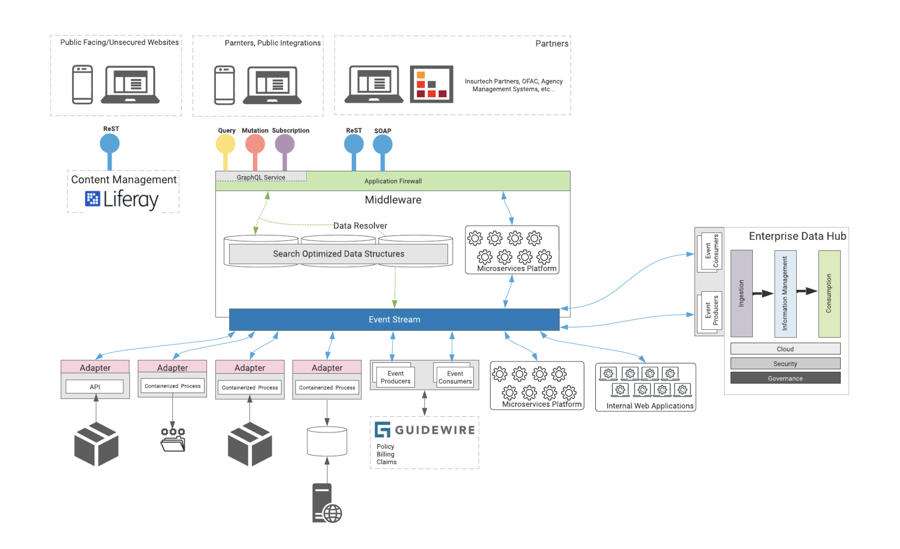
Event-driven Architecture

Slide 23
Event-driven Architecture Features
Loosely Coupled
Easy Integration
Supports many scaling models
“Data in Motion”
Favor asynchronous interactions
Instrumentation

Slide 24
Event-driven Architecture – Components
Two Major Components

Slide 25
We should start thinking about our data differently.

Slide 26
Event-driven Architecture – Data In Motion (vs Data at rest)

Slide 27
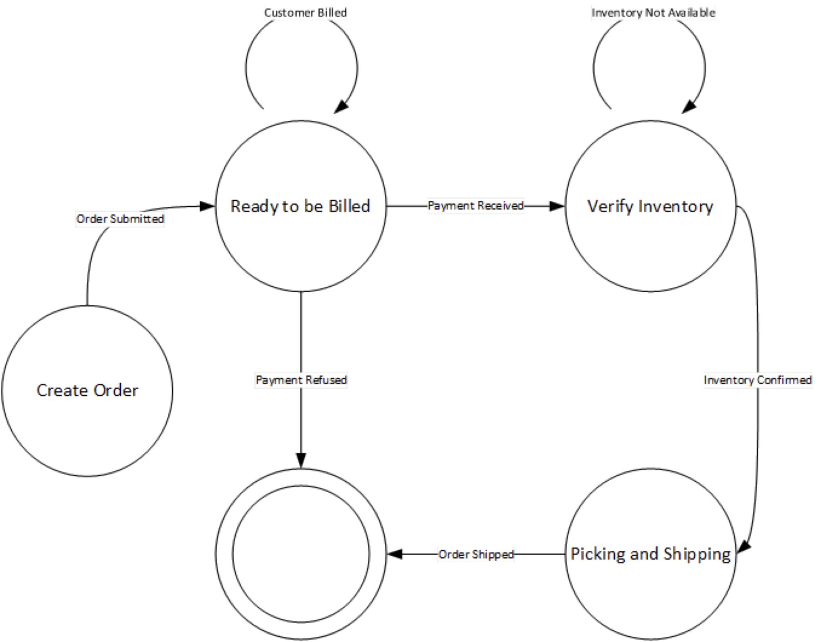
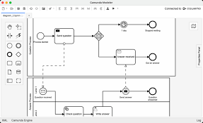
Business Process Automation
Orchestration
Governed by State Diagram
Producing and Consuming Event messages in a pre-defined order
Choreography
Governed by Tooling
Low-code/No-code
Encoded processing of Events messages in a pre-defined order

Slide 28
Event-driven Architecture

Slide 29
Calls to Action
More Collaboration between BCS and the Tech SL.
High-level common approach to Enterprise Integration Architecture
Upskill to modern techniques

Slide 30

Contact Us
Shawn Wallace
Principal Architect, Tech SL
614 - 270 – 1600
shawn.wallace@centricconsulting.com
www.centricconsulting.com
30
Notes:
- The next steps section will be your wrap up and thank you slides. We are going to add a slide for you to be able to list what’s next before we move to the contact us slide, so that will be available when we distribute the deck to all of Centric.

